Slide 1
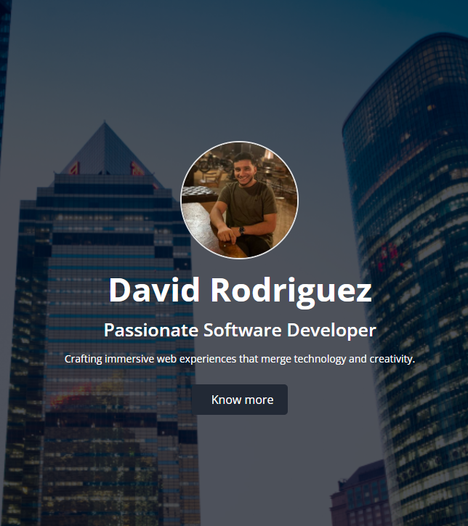
Presentation Curriculum Vitae Capstone
By David Rodriguez
SEPTEMBER 2023

Slide 2
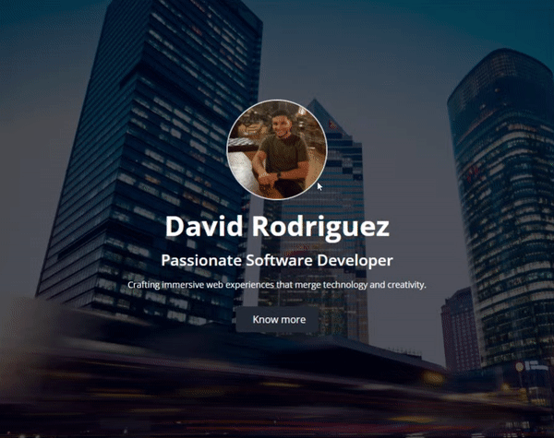
User Interactions
example
Home page
First Glimpse of the Website is a Brief Profile.
You can see a user's photo who has their resume in this section.
There's a title for their name and a subtitle for a brief self-description.
A brief description of any content the person creating the resume wishes to include.
A button to proceed with the person's content

Slide 3
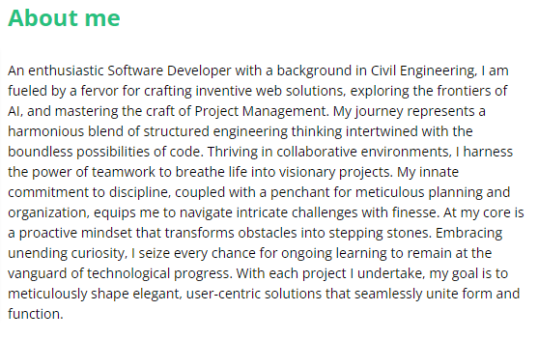
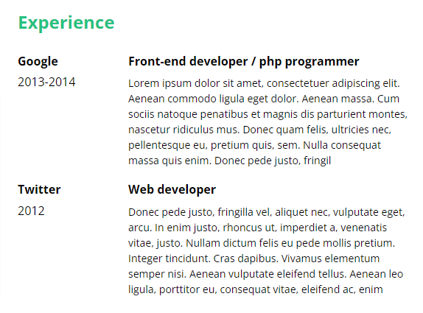
Static Components
example
About you
Your expertise
A short section or description in which a person introduces themselves in a simple manner.
A brief portion of a document or profile where an individual provides a concise overview of their past work, skills, and professional history.

Slide 4
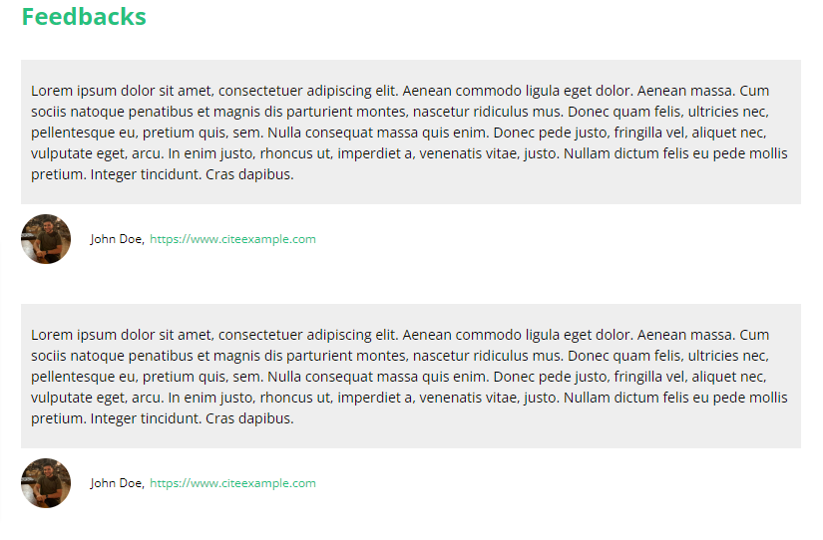
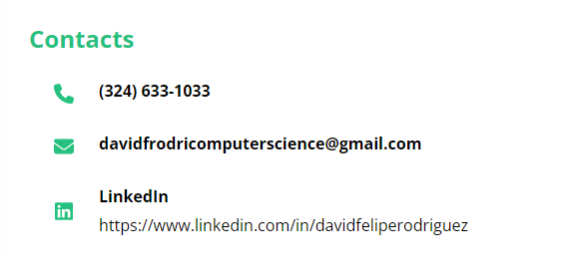
Static Components
example
Addresses
Recommendations and feedbacks
Refer to specific locations or contact information, such as physical addresses, email addresses, or other ways to reach individuals or entities
Comments or statements provided by others to express their support, approval, or evaluation of someone's work, skills, or qualities

Slide 5
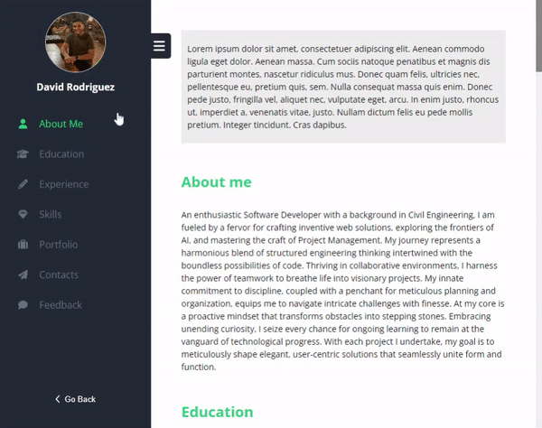
User Interactions
example
Dynamic Slide Navigation
Minimizable for Comfort: Users have the option to minimize it, allowing for a more comfortable viewing experience of the page's content.
Visible Navigation Icons: Even when minimized, users can still see and access the navigation icons, ensuring easy navigation throughout the site.
Enhanced User Experience: This feature enhances the user experience by allowing customization of the component's visibility based on individual preferences.
Flexibility and Convenience: It offers users flexibility by giving them control over the component's visibility, adding convenience to their browsing experience.

Slide 6
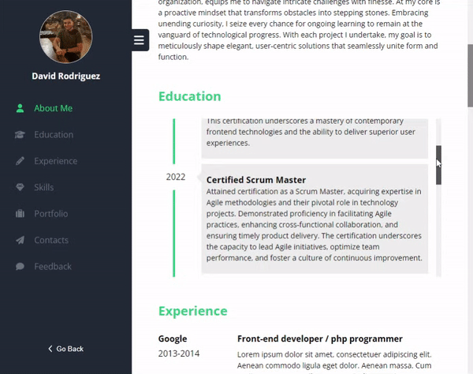
User Interactions
example
Timeline with your education
This component serves as an educational timeline, allowing users to showcase their academic background conveniently.
Visual Appeal: It offers a visually appealing way to display both a user's educational journey and a timeline with date markers indicating key educational milestones.
Interactive and Scrollable: Users can interact with and scroll through this component, making it easy to explore extended educational information.
Education Details: Users can input specific details such as institutions, degrees earned, and graduation dates.
Chronological Organization: The timeline automatically organizes educational experiences chronologically for clear understanding.

Slide 7
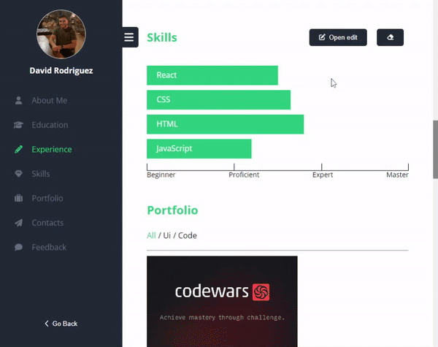
User Interactions
example
Skills Validations
Highly Visual Skill Representation: A highly visual representation of skills, with bars indicating the person's level of expertise.
Validation for Accuracy: Requires validation to ensure the skill name is provided.
Expertise Range Verification: Verifies that the skill is rated on a scale between 10 and 100.
Convenient Skill Management: Provides a convenient way to manage and display a user's skills and expertise.
Customizable Skill Entry: Allows users to customize their profile by adding their own skills and expertise levels.

Slide 8
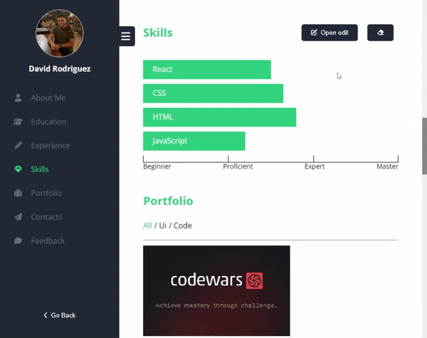
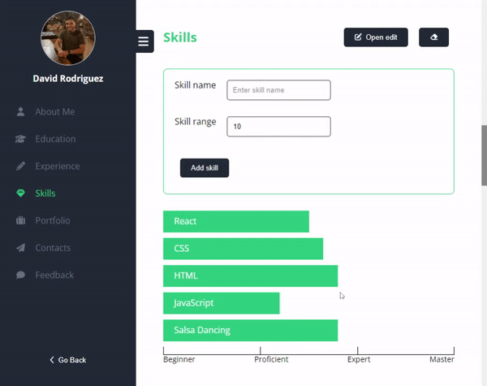
User Interactions
example
Add skills
Delete added skills
User-Friendly Skill Addition: Makes adding skills easy with a button that opens a form.
Skill Deletion Functionality: Additionally, there is a button to delete skills that have been added, providing users with the ability to manage and update their skillset easily.

Slide 9
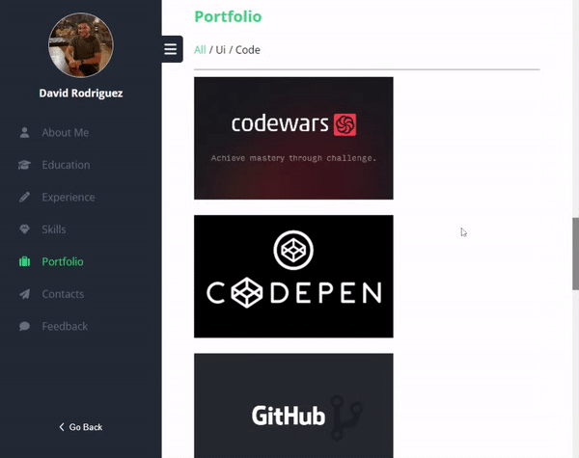

User Interactions
example
Interactive Portfolio (Hover)
Filter by categories
Deployment with more information about the project
Featured with filter and sorting the content with its respective category

Slide 10
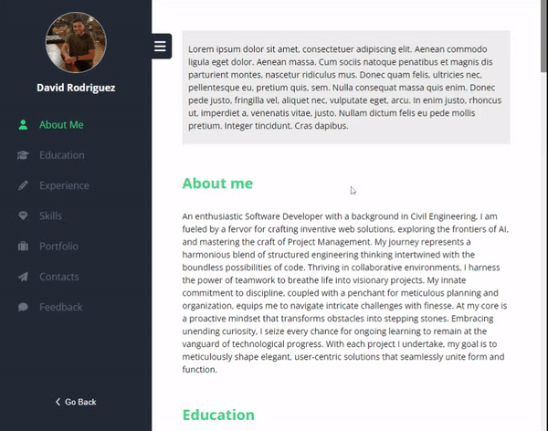
User Interactions
example
Position on Slide Navigation
Component Highlighting: Visually highlights the component currently on screen, making it easy to identify its location in the document.
Visual Position Indicator: Provides a visual indicator on the slide to show where the user is within the document, improving orientation.
Efficient Navigation: Allows users to click on navigation elements to scroll directly to the corresponding part of the document, streamlining navigation.
Enhanced User Experience: Overall, enhances the user experience by making navigation more intuitive and visually informative.

Slide 11
Let me show you some CODE
SEPTEMBER 2023

Slide 12






Conclusions
example
Recommendation
During this period of website creation, we successfully achieved the objectives outlined by the fast track criteria.
We developed a web page that allows users to view a person's resume with interactive components.
React was utilized for building the user interface, while SCSS was employed for styling, resulting in an attractive and responsive design.
Redux Toolkit was implemented for centralized and efficient state management, simplifying data management and interaction between components.
MirageJS was employed to simulate a backend and mock API calls, facilitating agile development and application testing without reliance on a real server.
Refine Testing: It is recommended to refine certain aspects, such as testing. While the test coverage is good, there are still some lines of code that have not been covered. Improving test coverage can enhance code reliability and robustness.
Expert Review: Consider conducting a comprehensive review of the components by collaborating with a more experienced professional. This review can help identify and address any potential critical implementation issues and ensure best practices are followed.
Transition to a Dashboard: To enhance the application, consider transitioning from a static page with individual information to a dynamic dashboard. This would provide a platform for creating resumes and require implementing user authentication and private routing for resume creation.

